Slide 1
Module 22

Slide 2
If it is so important that hormones should be secreted in precise quantities, we need a mechanism through which it is done.
exact
The timing and amount of hormones released are regulated by feedback mechanism.
Controlled
Let us see feedback mechanism.

Slide 3







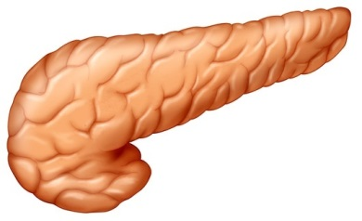
If the glucose concentration increases in the blood the increased glucose level is detected by the cells of the pancreas
Feedback mechanism
G
G
G
G
G
G
G
G
G
G
G
G
G
I
I
I
I
I
I
I
I
I
I
The cells of the pancreas responds to the situation by producing more insulin.
G
G
G
G
G
G
G
G
G
G
G
G
G
Insulin reduces the glucose concentration in the blood
I
I
I
As the sugar level of the blood falls, the secretion of insulin by the pancreas is reduced
I

Slide 4
Thank You

